Slide 1
Nice to meet you!

Slide 2
Ready, steady, go
Red – Я жду урок с нетерпением
Orange – Я готов к уроку
Green – Я буду стараться

Slide 3
Autumn
Autumn leaves are falling down
To the ground, to the ground
They are falling day and night,
Green and …, red and ….

Slide 4
Autumn
Autumn leaves are falling down
To the ground, to the ground
They are falling day and night,
Green and yellow, red and bright.

Slide 5
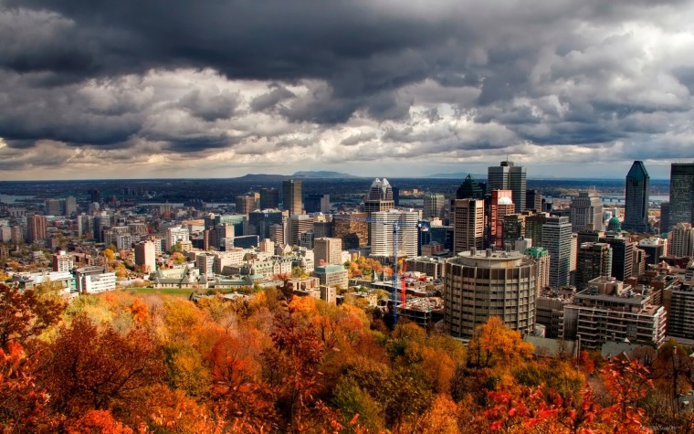

Slide 6
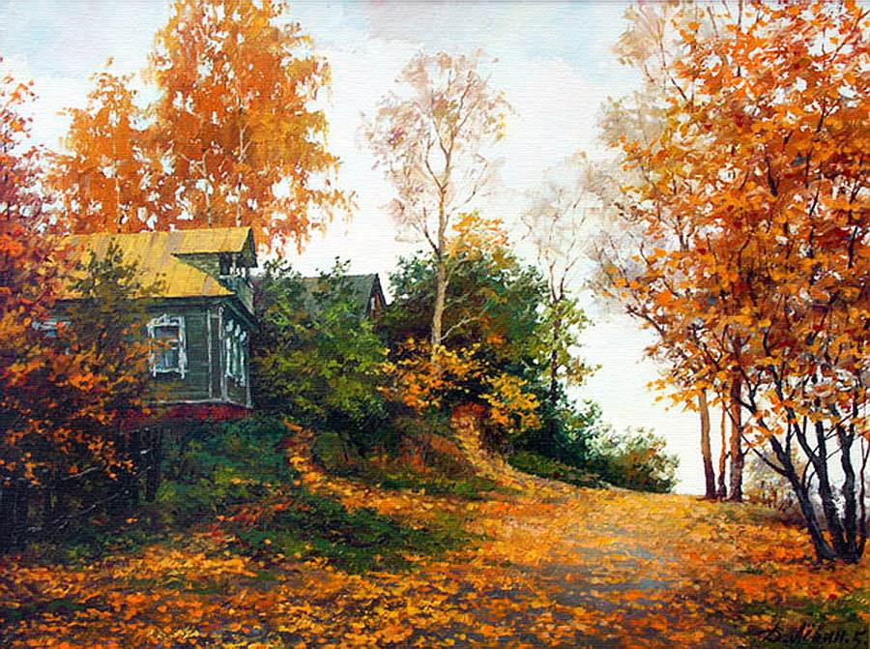

Slide 7
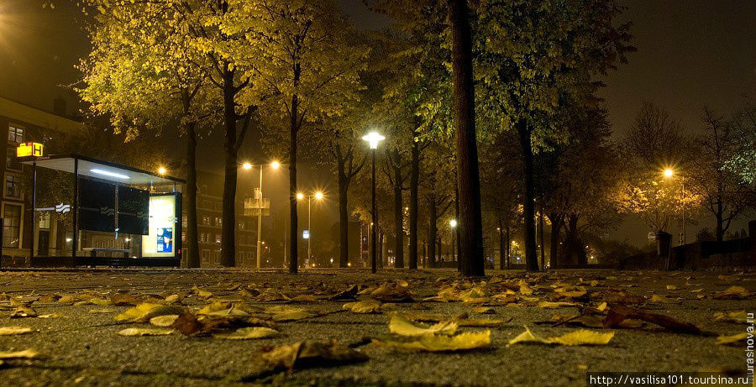

Slide 8
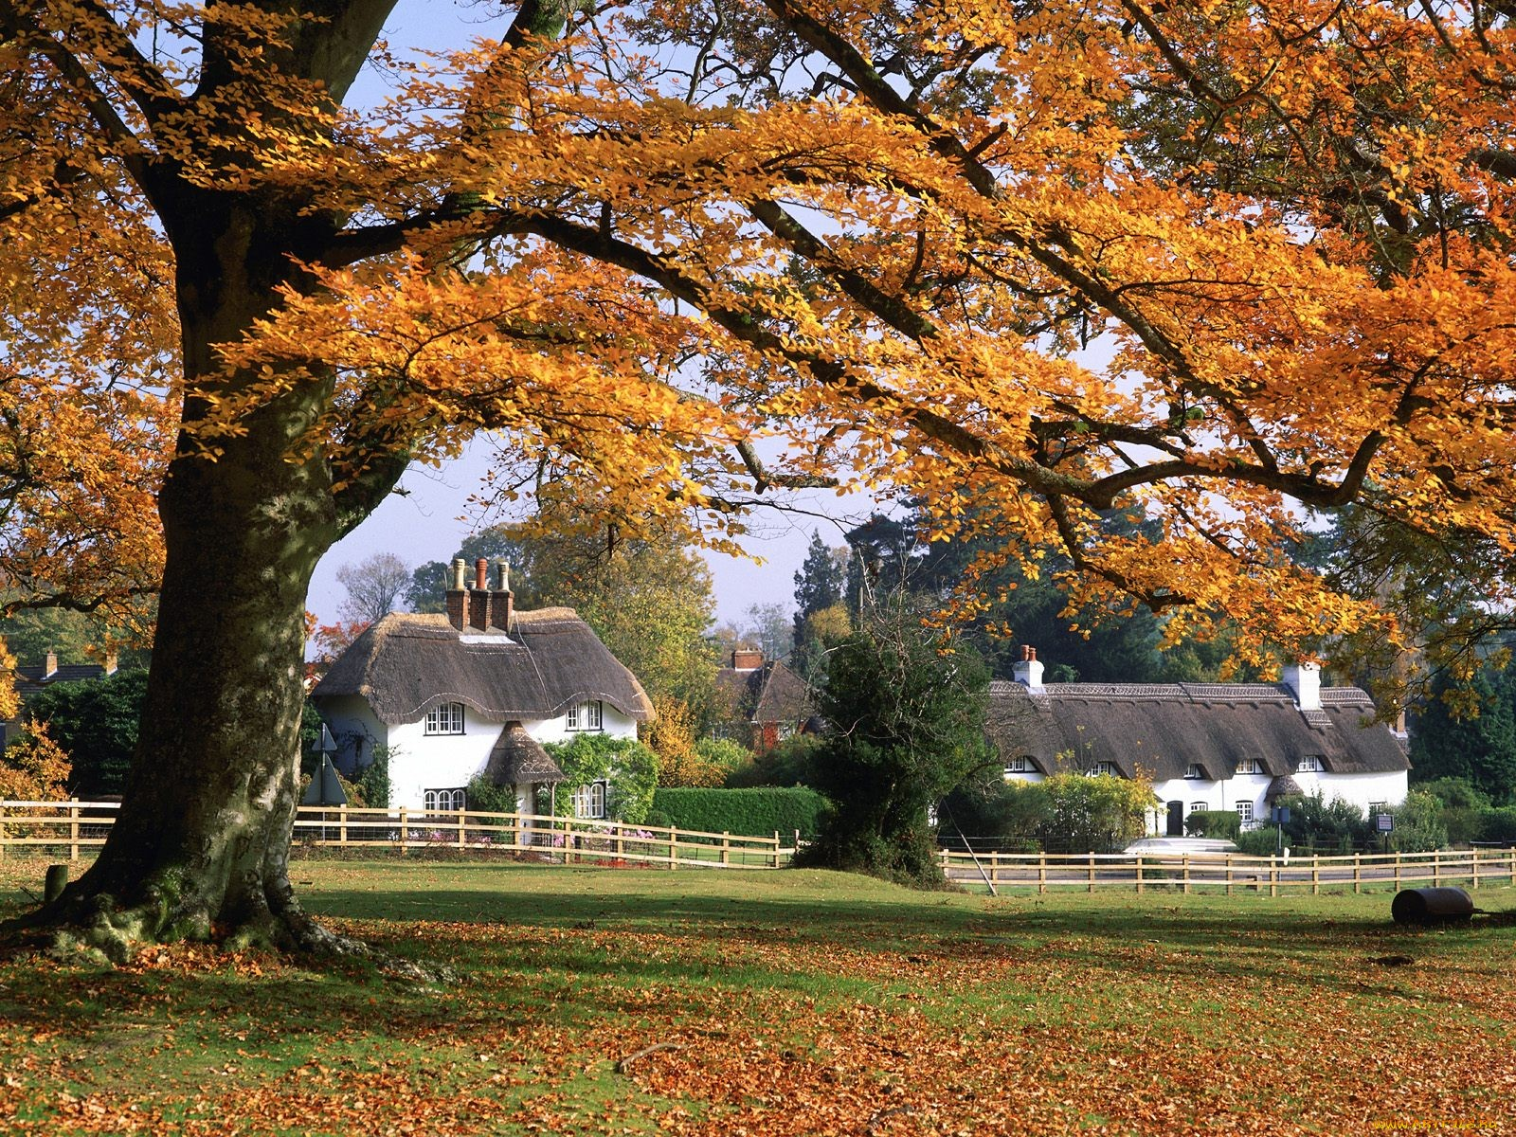

Slide 9
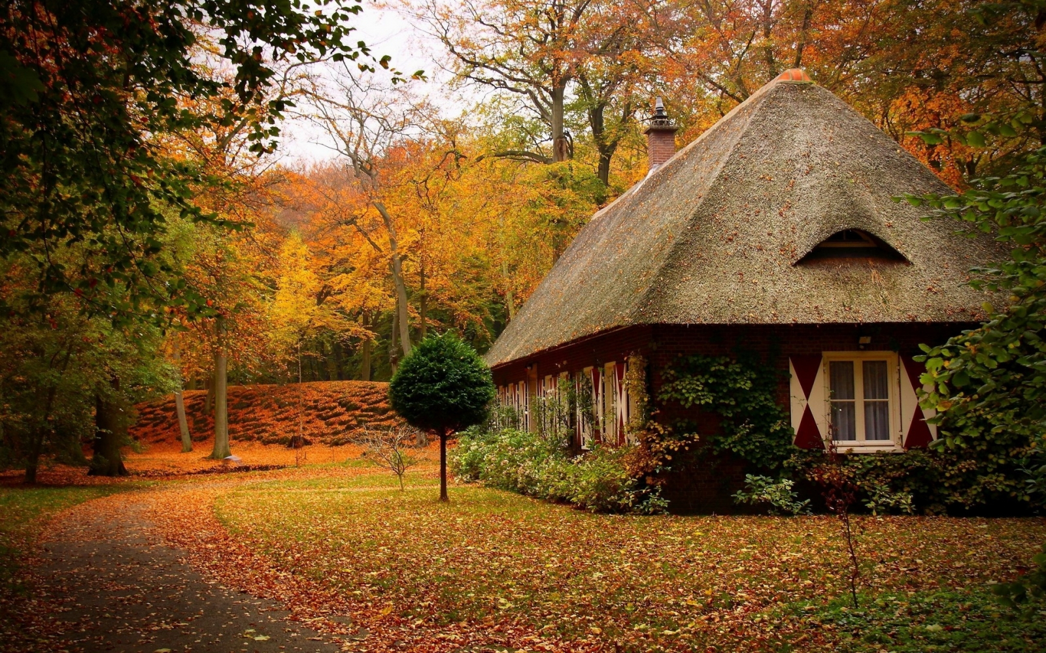

Slide 10
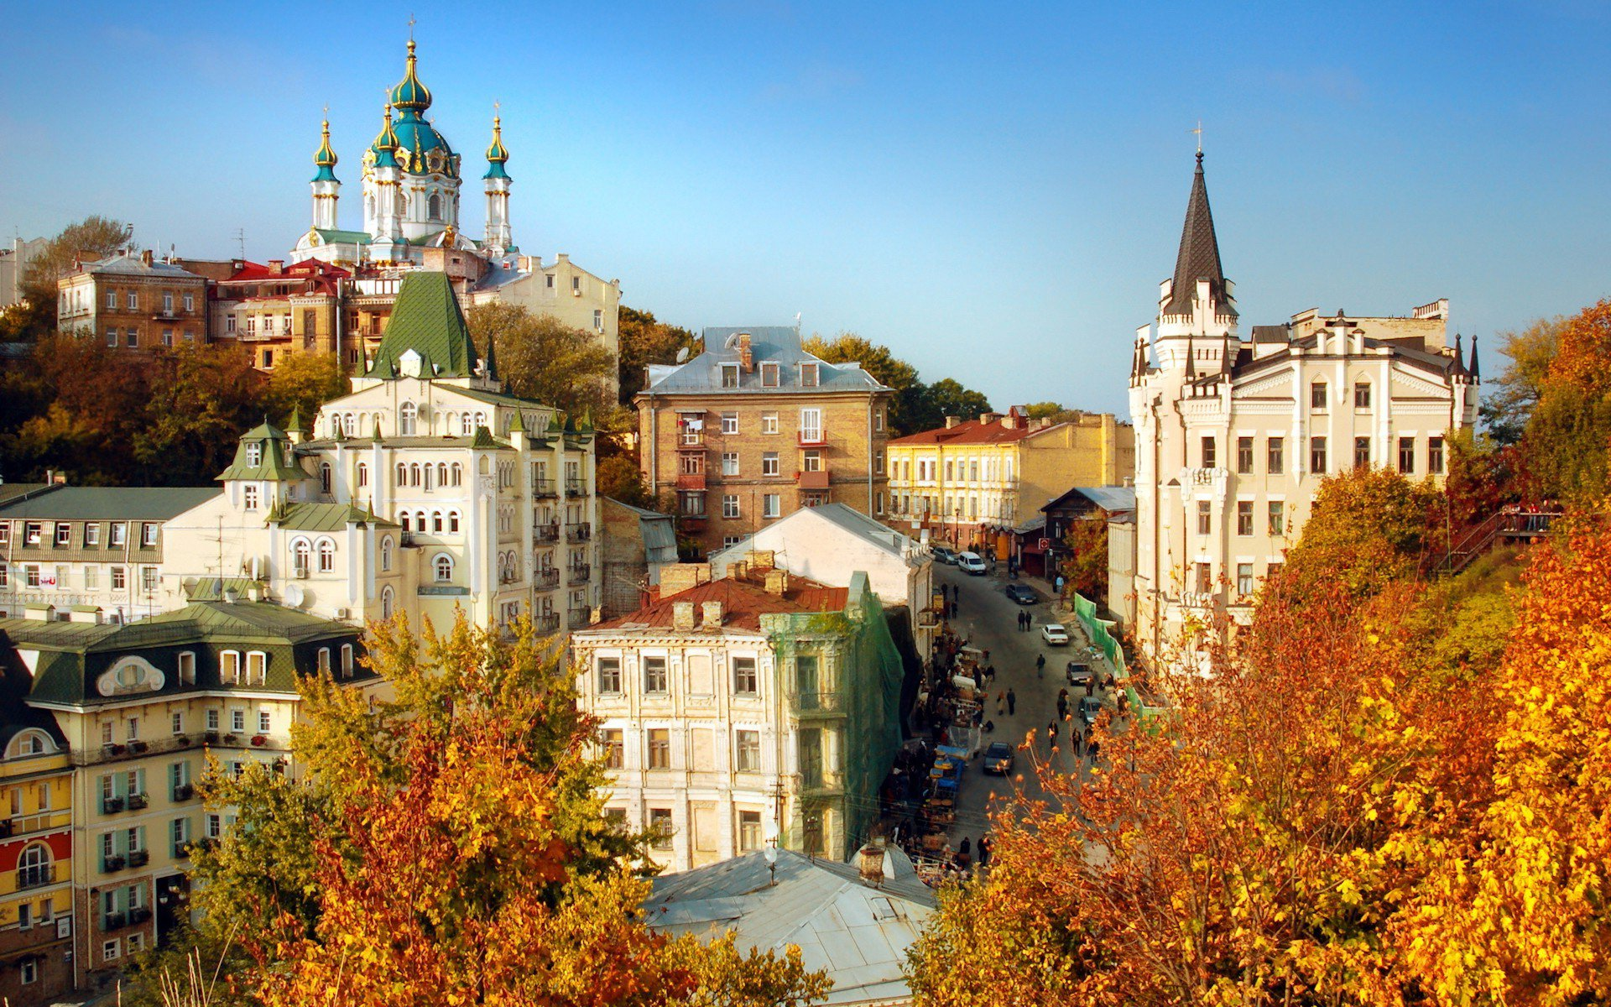

Slide 11
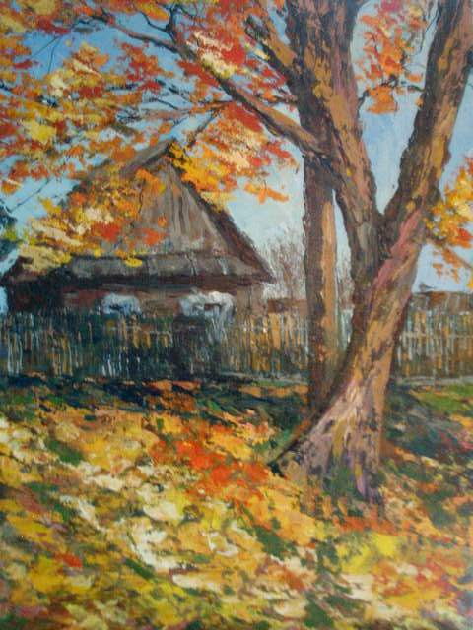
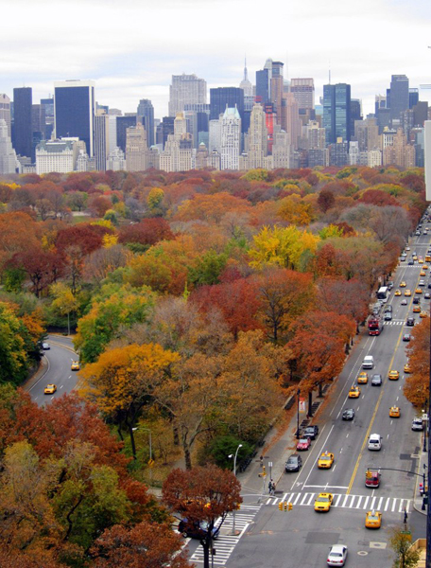
The country and the city

Slide 12
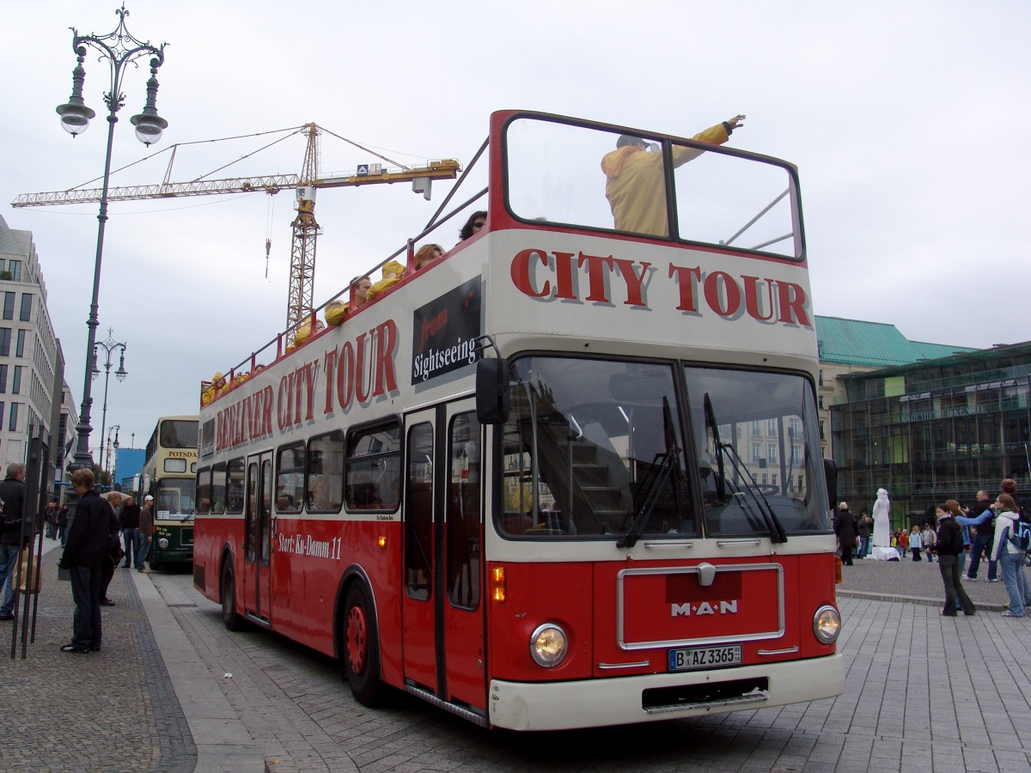

Slide 13
- S (es)
iz
a rose
a box
a bench
a bus
a boss
S
a cat
a map
a pet
a zip
a kite
z
a kid
a dog
a log
a bear
window

Slide 14
Remember!
A man – men
A woman – women
A child – children
A mouse – mice
A sheep – sheep

Slide 15
Words in plural
Cities, towns, farms, streets, cars, houses, fields, hills, rivers, gardens, apple trees, cows, horses, sheep,
And wishes

Slide 16
Ready, steady, go
Red – Fine!
Orange – Ok!
Green – All will be great!

Slide 17


